Slide 1

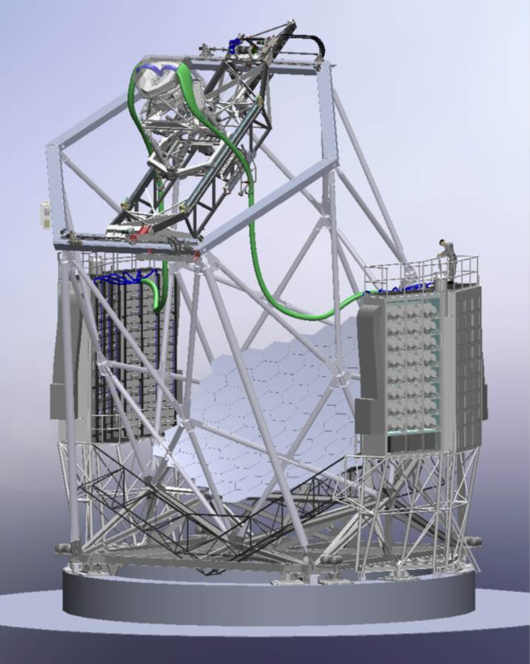
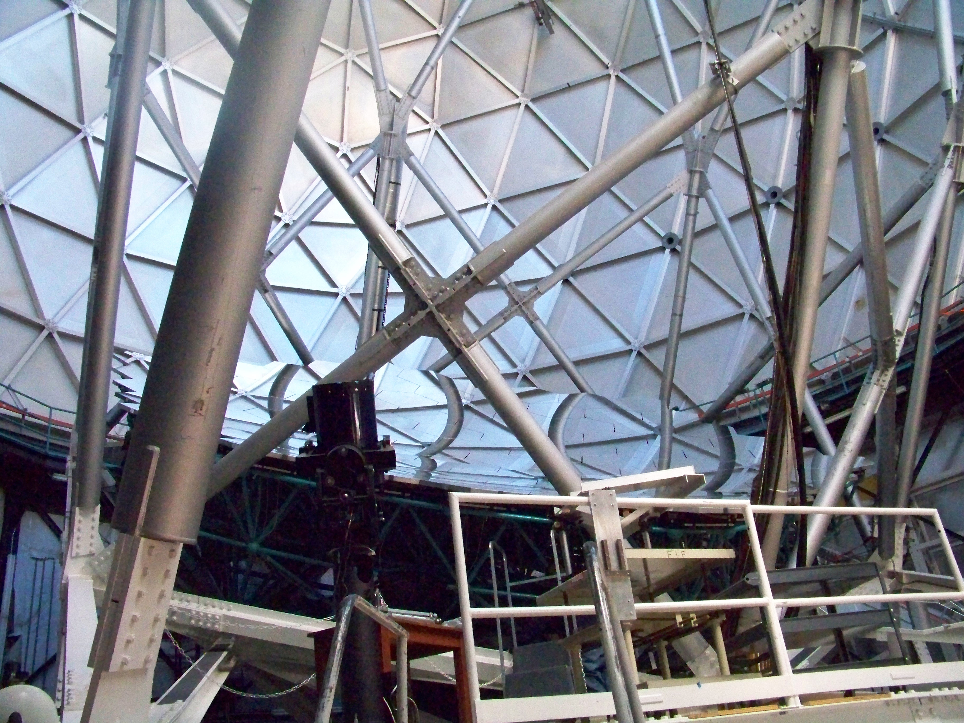
The Habitable-Zone Planet
Finder (HPF) for the Hobby-Eberly
Telescope
Larry Ramsey
For the HPF team
(Penn State University)
Photonics & Planets, November 6 & 7 2014 Florence Italy

Slide 2
The HPF Team
HPF Blog: hpf.psu.edu
Suvrath Mahadevan (PI)
Graduate Students Researchers & Engineers
Ryan Terrien Paul Robertson
Sam Halverson Chad Bender
Arpita Roy Christian Schwab
Guodmundur Kari Steffanson Fred Hearty
Rob Marchwinski Larry Ramsey
Eric Levi
UVa & NIST Collaborators: Matt Nelson (UVa), Steve Osterman (CU), Scott Diddams, Gabe Ycas, Frank Quinlan (NIST)

Slide 3
Earths & Super Earths Around M Dwarfs
Mid/Late M stars are attractive targets since RV amplitude of terrestrial planets in HZ is so much higher than around F, G, K.

Slide 4
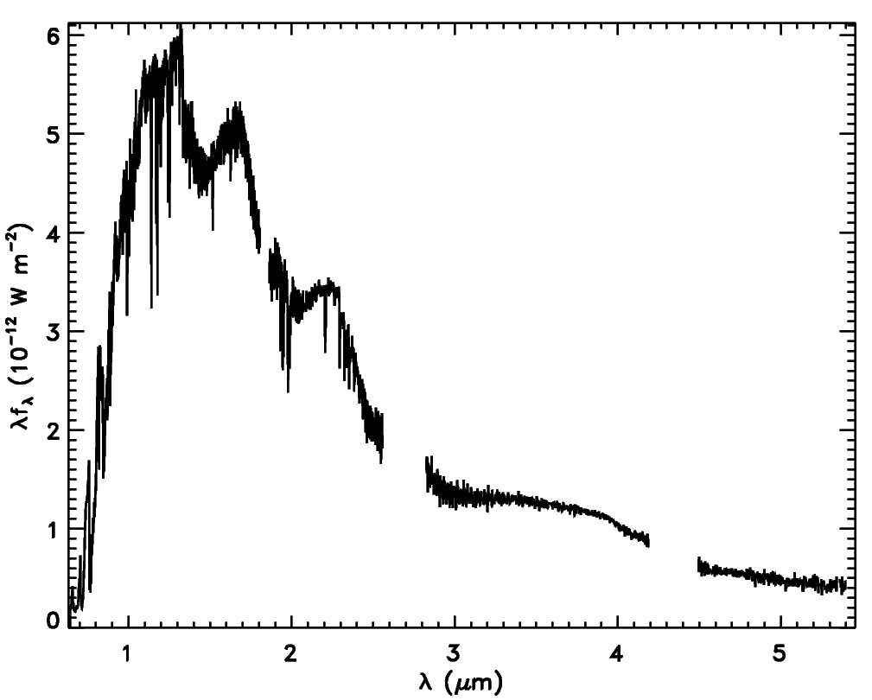
Earths & Super Earths Around M Dwarfs
System | ΔRV (m/s)
Sun-Jupiter | 12.5
Sun-Earth | 0.089
Proxima Cen -Earth (1 AU) | 0.4
Proxima Cen -Earth (Hab. Zone) | 1.3
Y+J+H
V
M dwarfs emit most of their photons in the red and NIR.
(Pavlenko et al. 2007)
A NIR spectrograph can probe mid-to-late M dwarfs.

Slide 5
The NIR Bands
The Y band is quite clean compared to J and H, and has a lot of of RV information for mid-late M dwarfs……

Slide 6

Habitable Zone Planet Finder (HPF) on the HET
Development and Construction of HPF Funded by NSF MRI

Slide 7
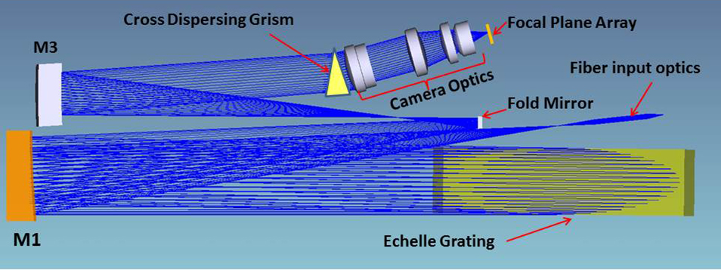
HPF on HET
R~ 50,000
f/3.65 fiber input at telescope focal plane
~3pixel sampling of Resolution element
Asymmetric White Pupil design, ‘R4’ Echelle, VPH cross Disperser
RV precision < 3m/s (requirement), goal of 1m/s
H2RG cooled to ~100 K
Rest of instrument cooled to 180 K

Slide 8

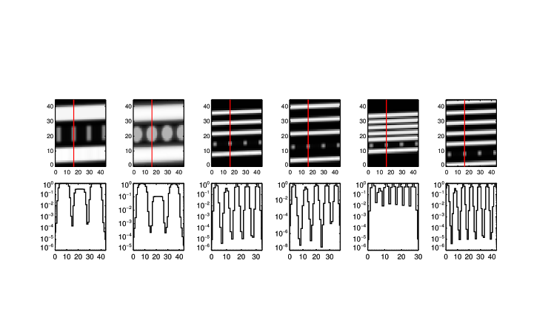
HPF on HET
Simulations of various fiber configurations for HPF including science, sky and calibration.
Covers Z, Y & J bands 820 nm (100% of order 74) to 1250 nm 69% of order 48) on one H2RG. One science fiber, calibration fiber and sky fiber.

Slide 9
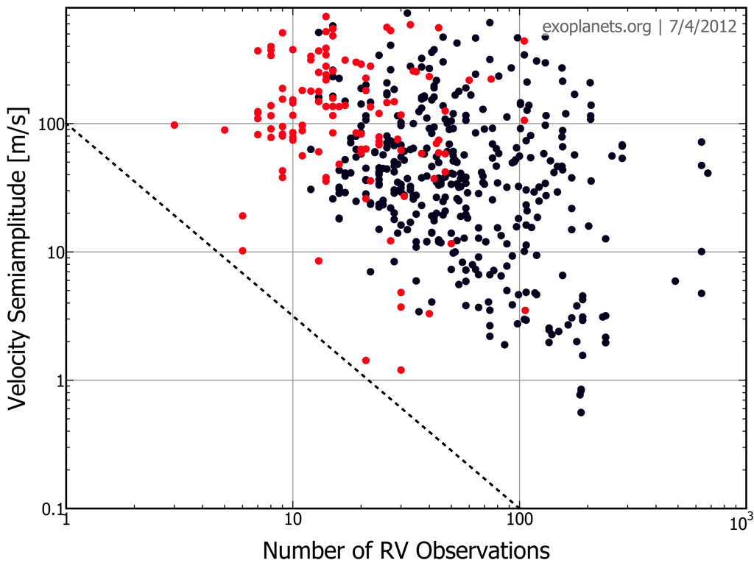
HPF on HET: Survey
Need a large number of RV observations to detect non-transiting planets. Sample is ~300 M dwarfs, with ~50-100 most promising getting 100 RV observations.
Whole HPF Survey is HET queue based

Slide 10
HPF on HET
Target Lists being populated, Fe/H, visni’s being determined for a large number of M dwarfs with IRTF & APOGEE. (Ryan Terrien, PhD Thesis)

Slide 11
Challenges in NIR RVs
NIR Detectors (They are not CCD’s!)
Calibration is Key
Temperature & Pressure Stabilization with Cryogenic Instrument
Fiber Modal Noise, Scrambling
Stellar Activity
Telluric Absorption

Slide 12
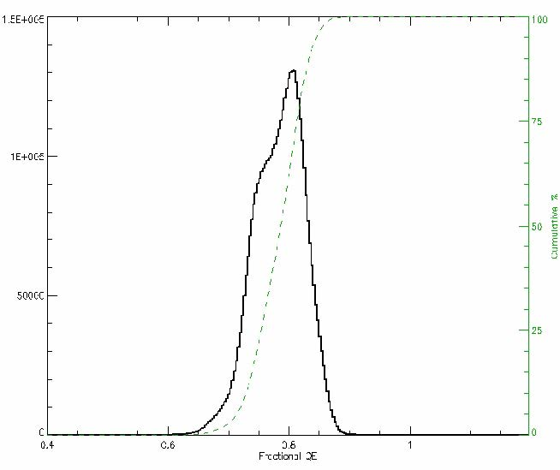
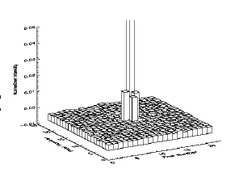
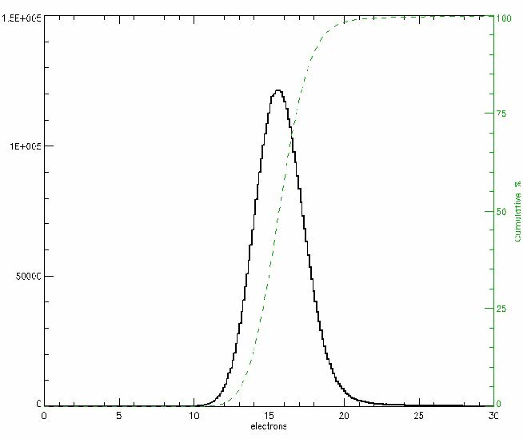
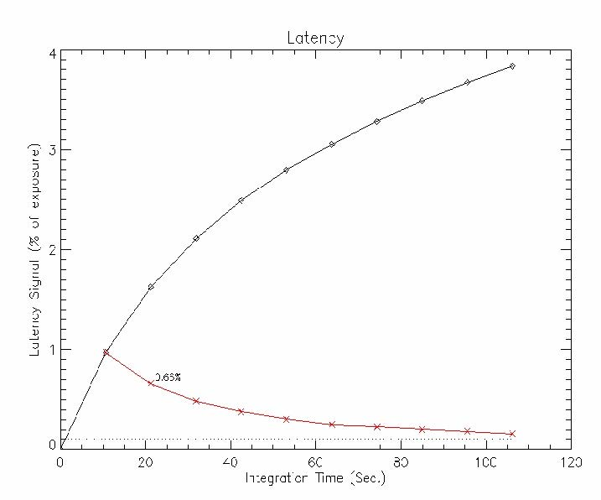
Challenges: NIR Detectors
Inter Pixel Capacitance
Wide QE Distribution
H2RG Devices
High and Variable Noise
Latency
(Persistence)
Image Credits:, Jim Beletic, Teledyne

Slide 13
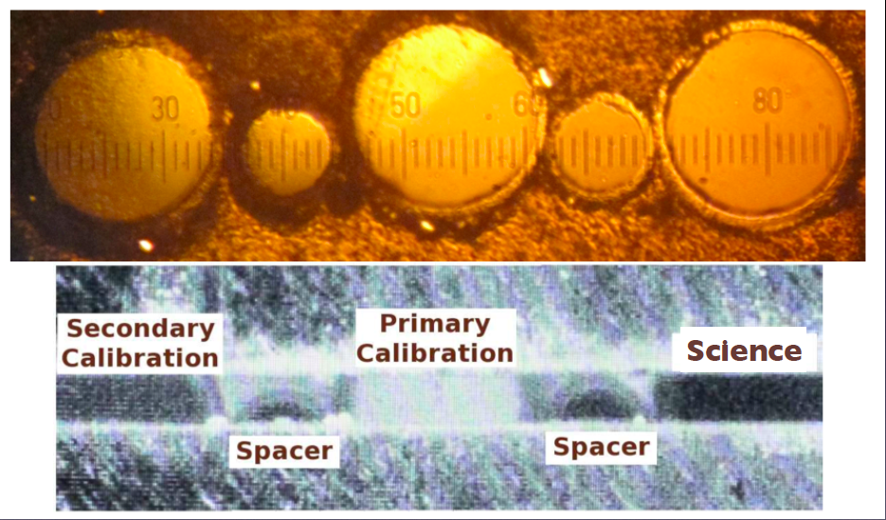
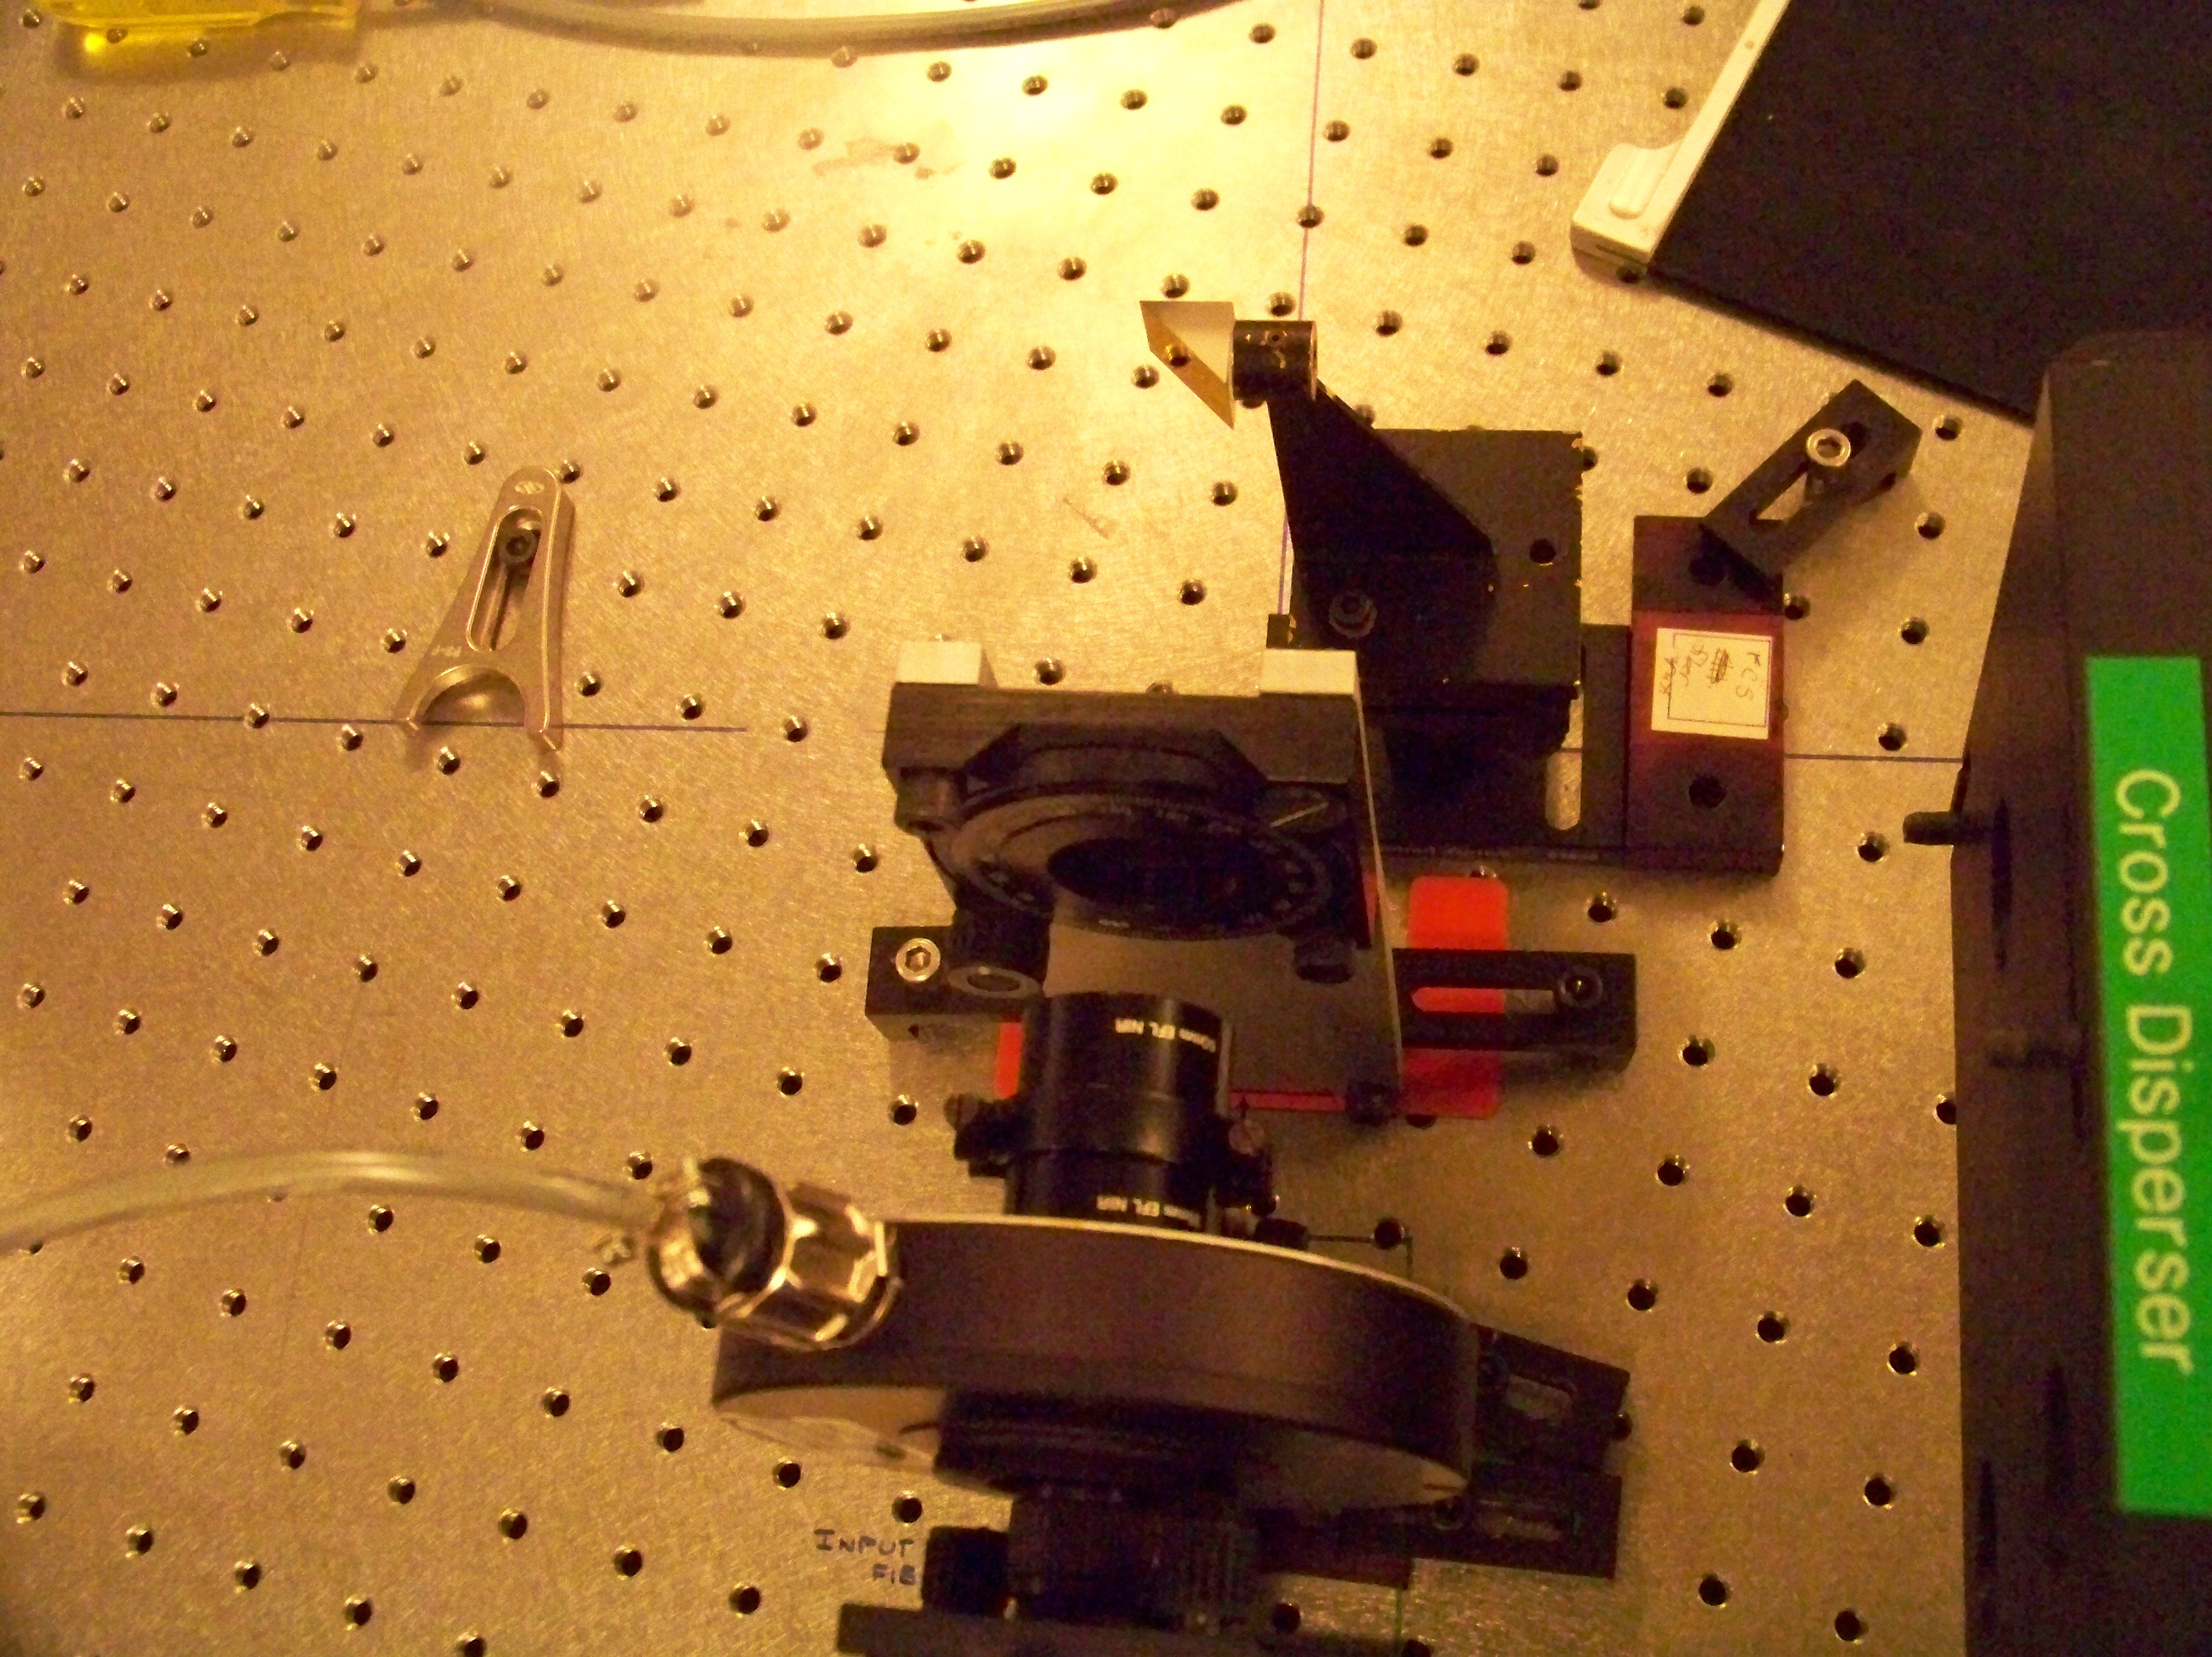
Pathfinder TESTBED
H1

Slide 14
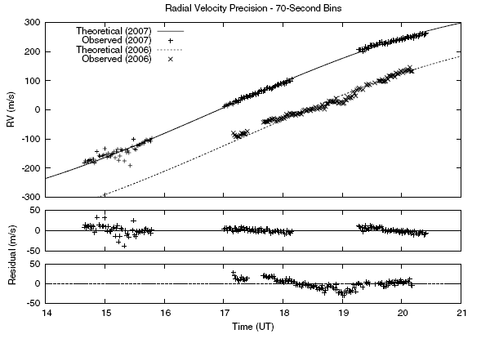
Pathfinder : On ‘Sky’ Performance in Lab
Ramsey et al. 2008
Achieve 7-10m/s rms scatter on Sunlight with two different configurations and simultaneous Th-Ar calibration. Suggests detector issues like persistence and parasitic ghosting are not a killer at ~< 10m/s. This is short term stability.

Slide 15
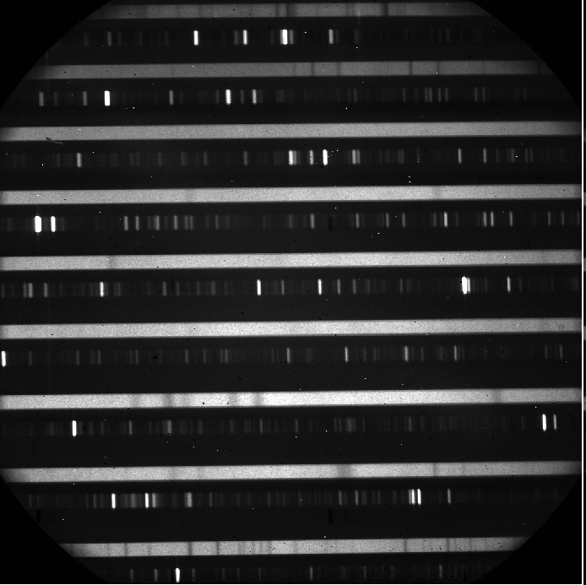
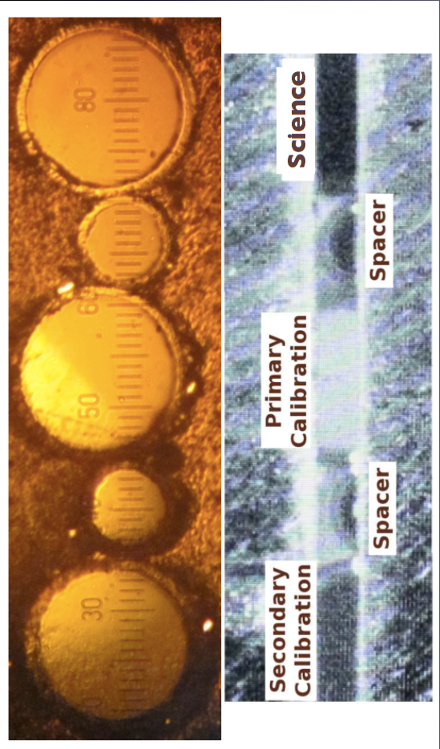
Pathfinder @ HET
star
U/Ne
Observations of Tau Boo with Pathfinder@ HET
Orbit Recovered

Slide 16
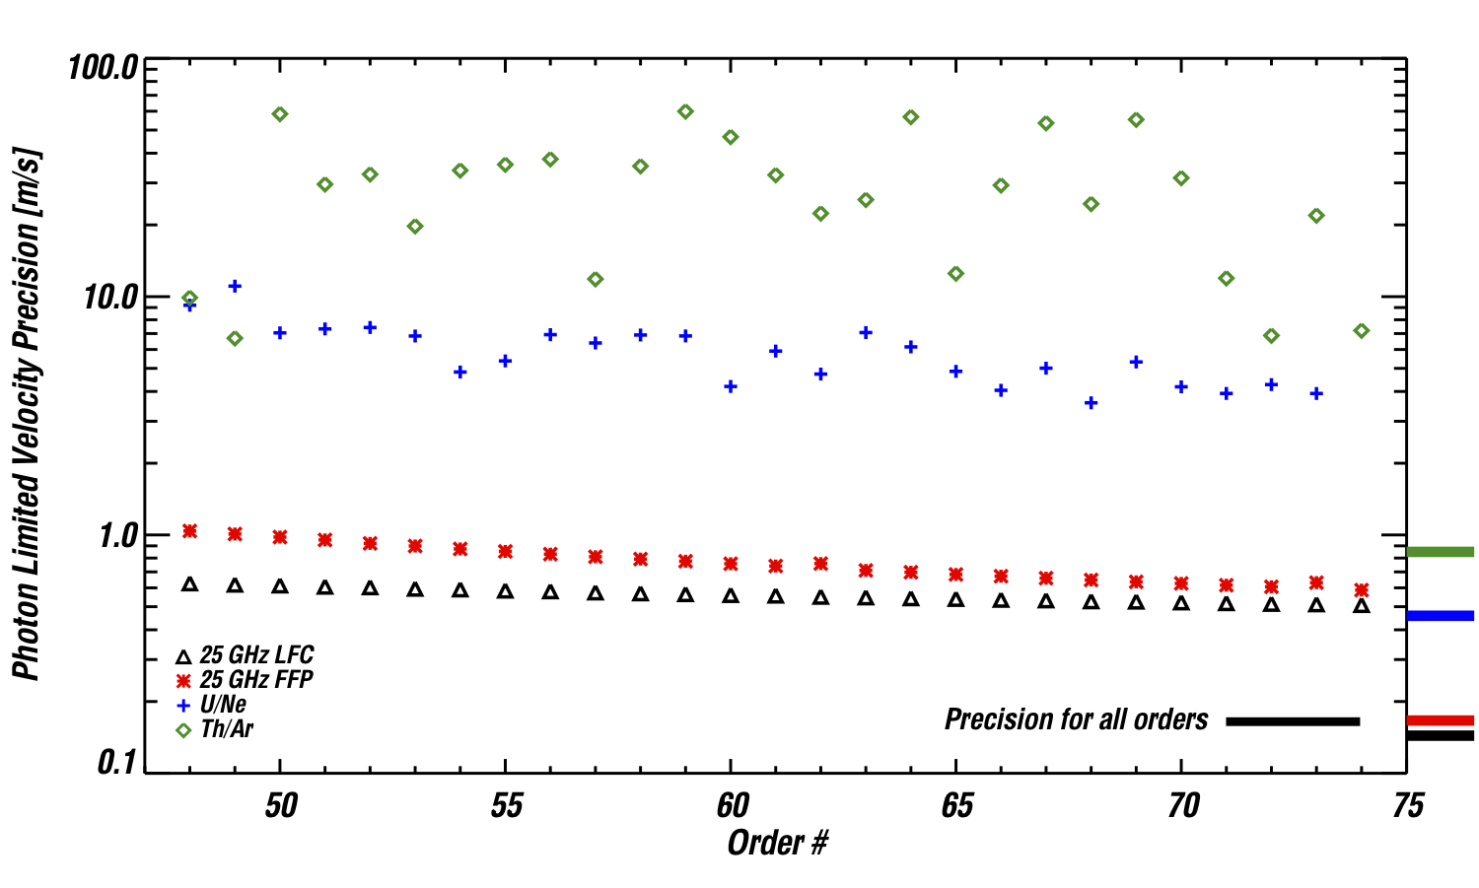
Calibration is KEY
FPRD
Requirment
HPF System Models based on archived line-lists, assumes S/N max of 300 in extracted spectrum
Notes:
When comparing the velocity information content of each of wavelength reference, you see the obvious benefits of using photonic references. These models all assume three pixel sampling of the resolution element, a resolution of 50,000, and a peak S/N of 300 in the extracted spectrum.
----- Meeting Notes (5/24/13 10:08) -----
emphasis this is only information content only, draw line at FPRD, we can get significantly higher s/n with 20 pixels spatially

Slide 17
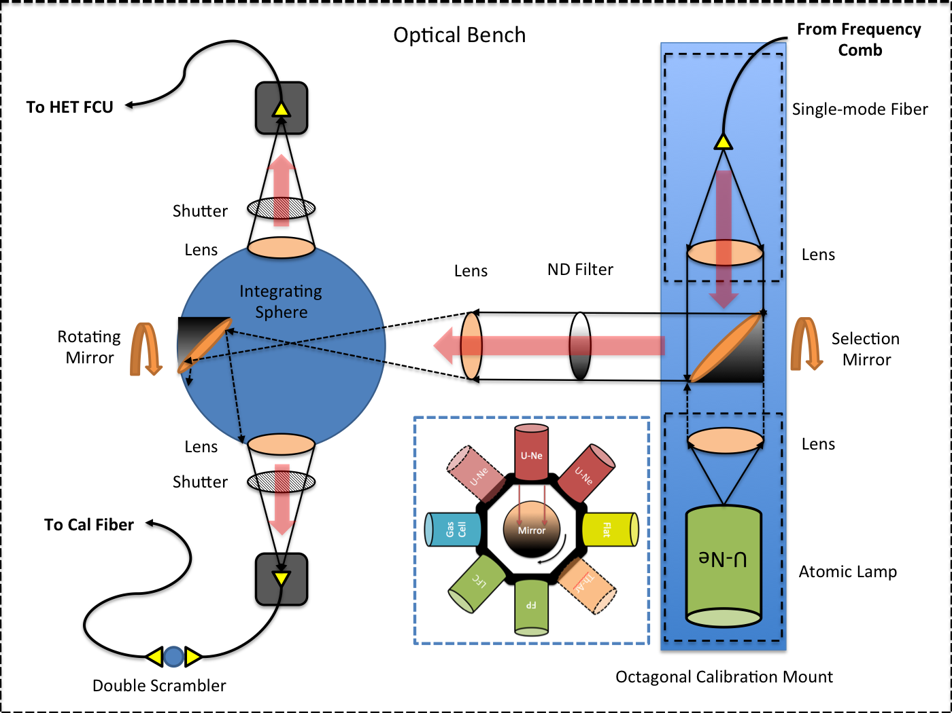
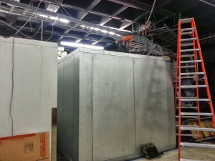
HPF Calibration System
The HPF calibration and laser comb are located in an insulated room adjacent to the HPF
The HPF Calibration systems feeds light from the different sources (FFP, comb, U/Ne, flat) into an integrating sphere which then feeds the HPF calibration fibers and the HET wide field calibration unit.
Sam Halverson SPIE 2014

Slide 18
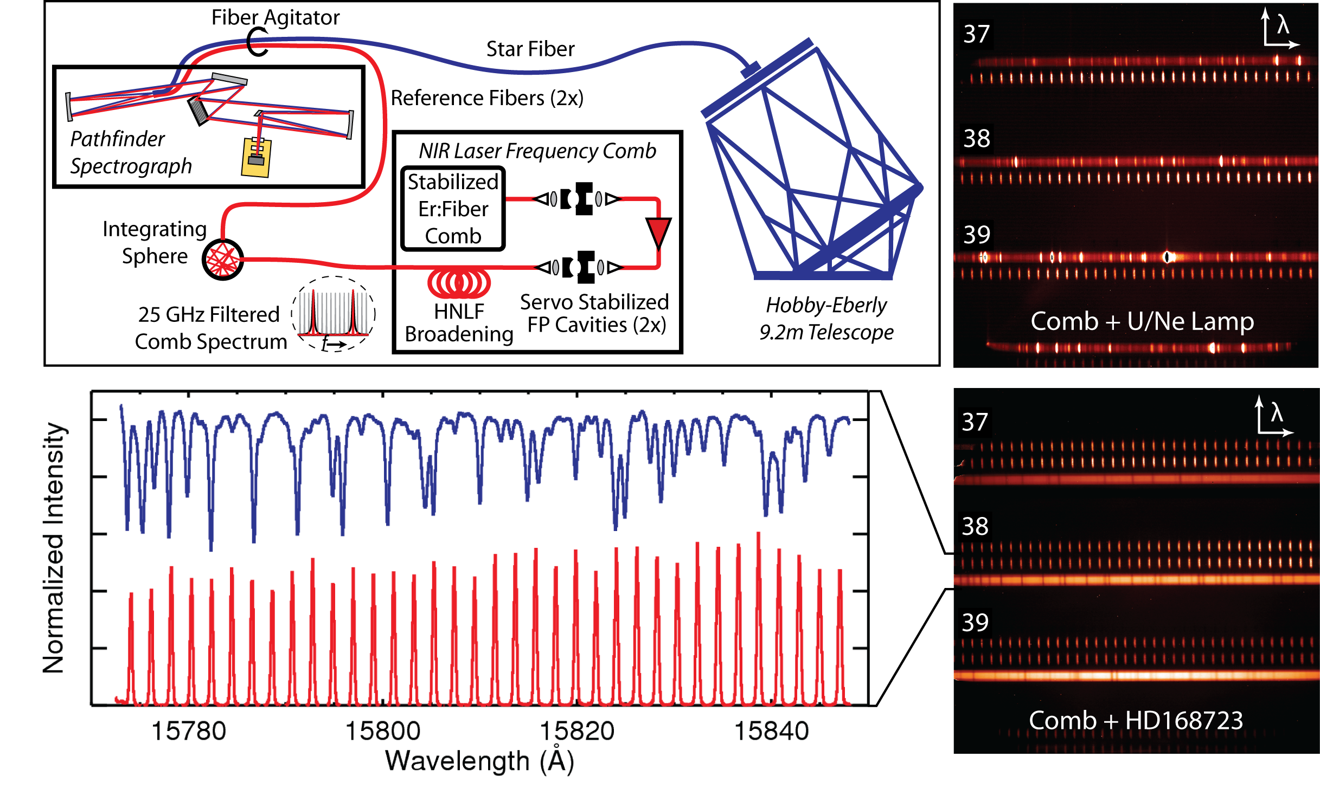
Pathfinder @ HET

Slide 19
RVs with Simultaneous Ref.
comb
star
Stellar NIR RVs with Laser Frequency Comb
Ycas et al. 2012, Optics Express

Slide 20
On-Star RV Results with a NIR Frequency Comb!
May-August 2010: 7-15m/s RV precision
“Absolute” RV for Eta Cas consistent with Nidever et al. 2002 to ~25m/s

Slide 21
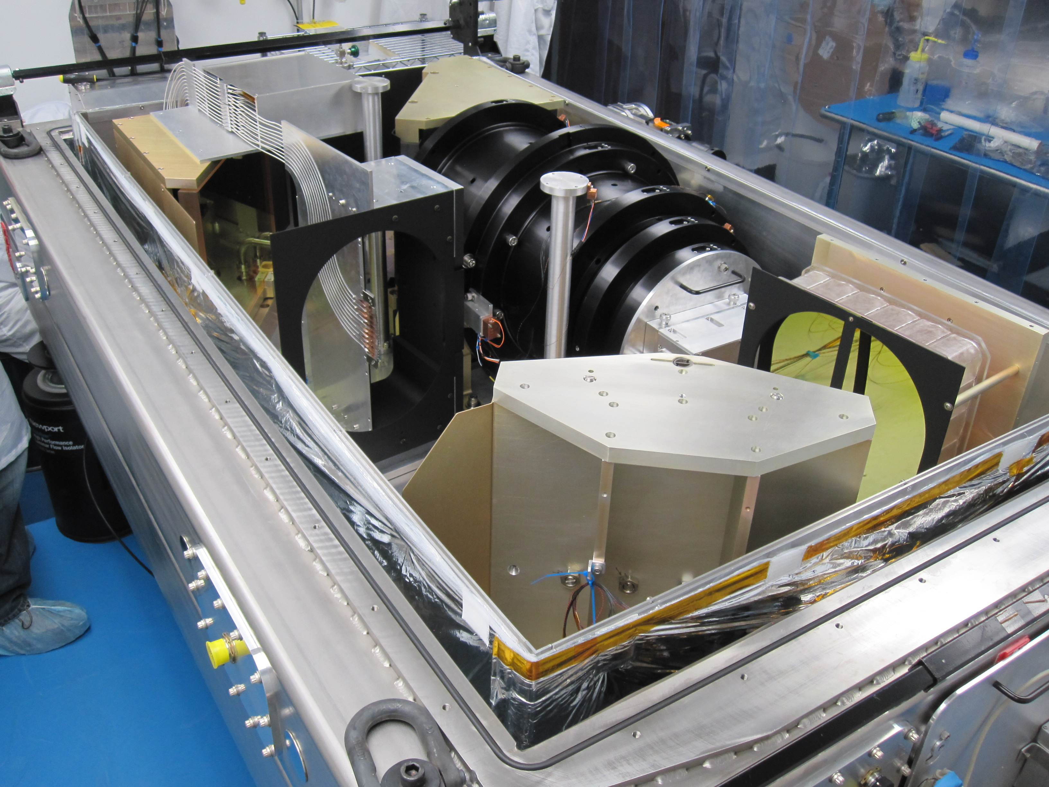
Calibration Is KEY
PATHFINDER SDSS-IIII APOGEE
~10m/s ~100m/s
U/Ne, Freq. Comb. Th-Ar, Sky OH

Slide 22
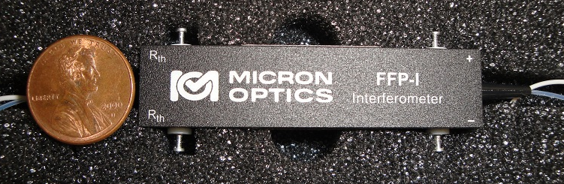
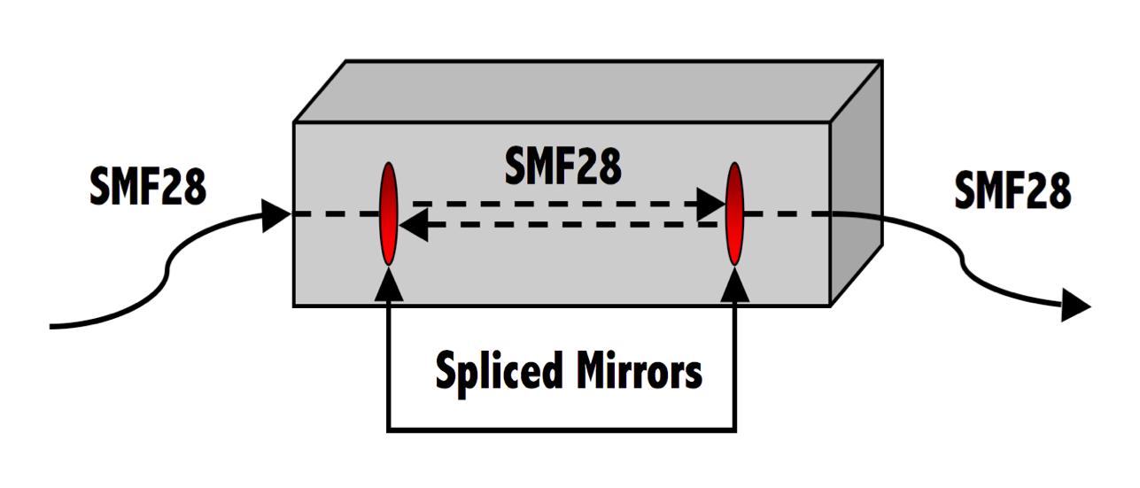
Fiber Fabry Perot: FFP
Fiber Fabry Perot: Compact, Insensitive to Vibrations.Collimation is not a Problem.
SMF 28 has a 8-10 micron Core
Halverson et al. 2012

Slide 23
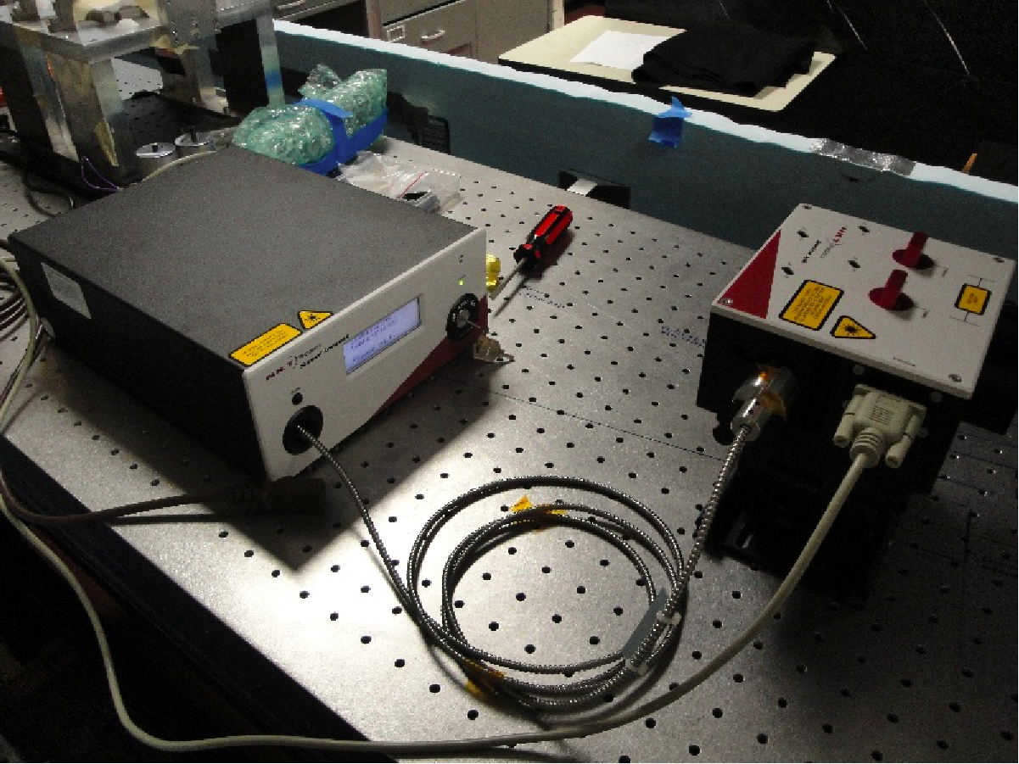
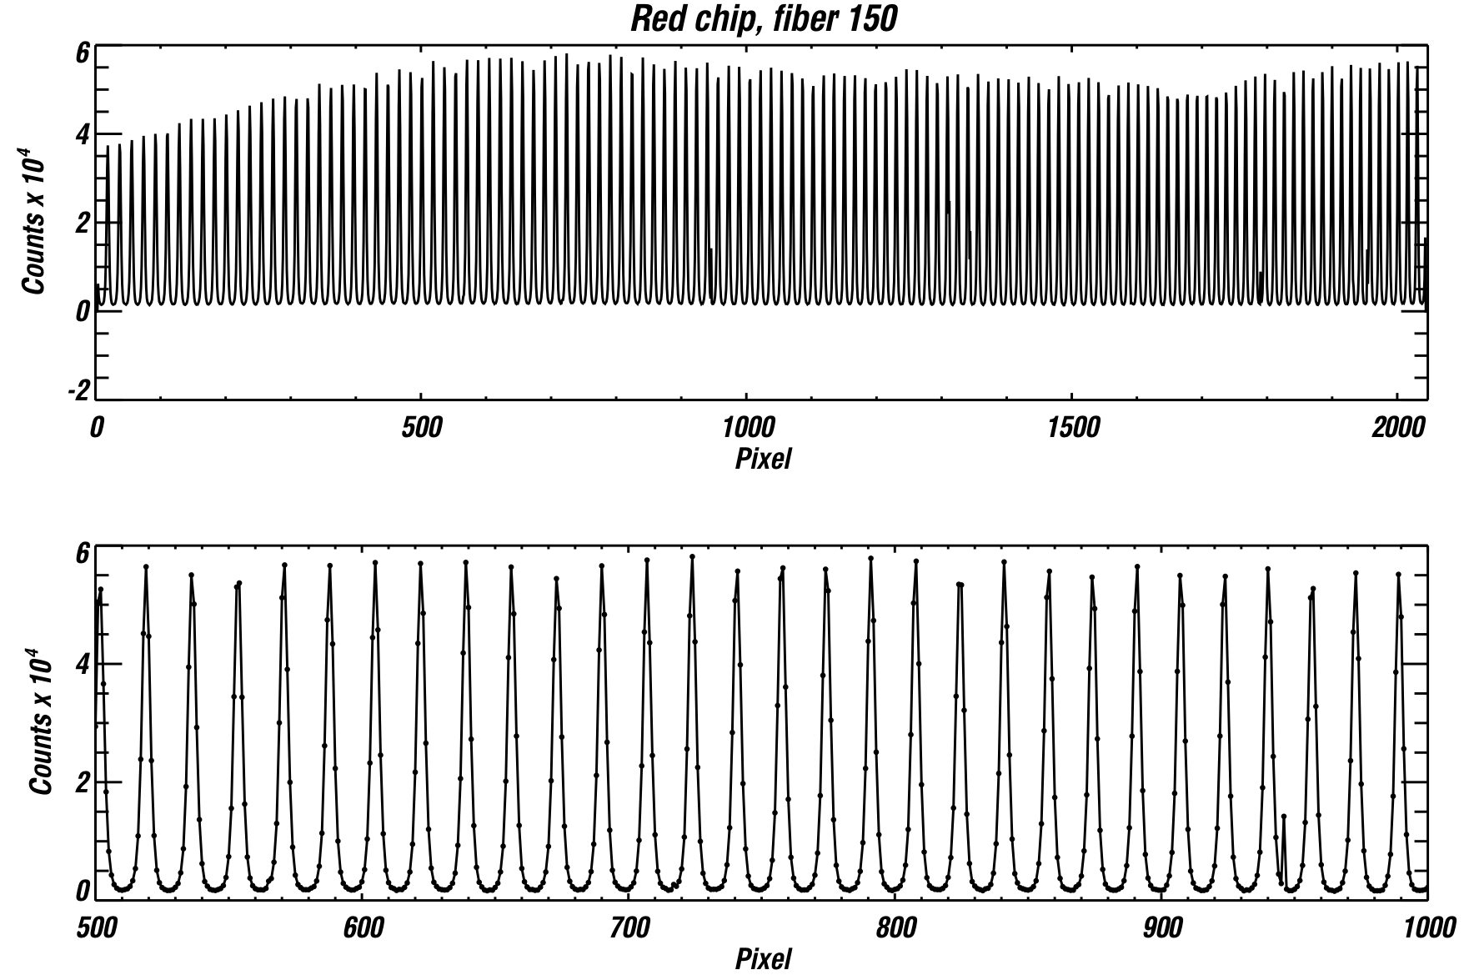
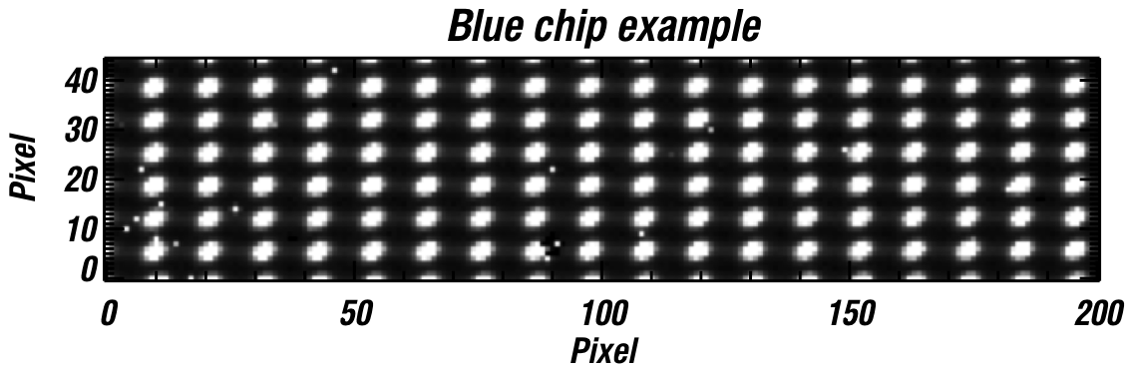
FFP+APOGEE
Needs a supercontinuum source to feed enough light through the 8micron core.
Expected Stability ~1m/s

Slide 24
FFP+APOGEE

Slide 25
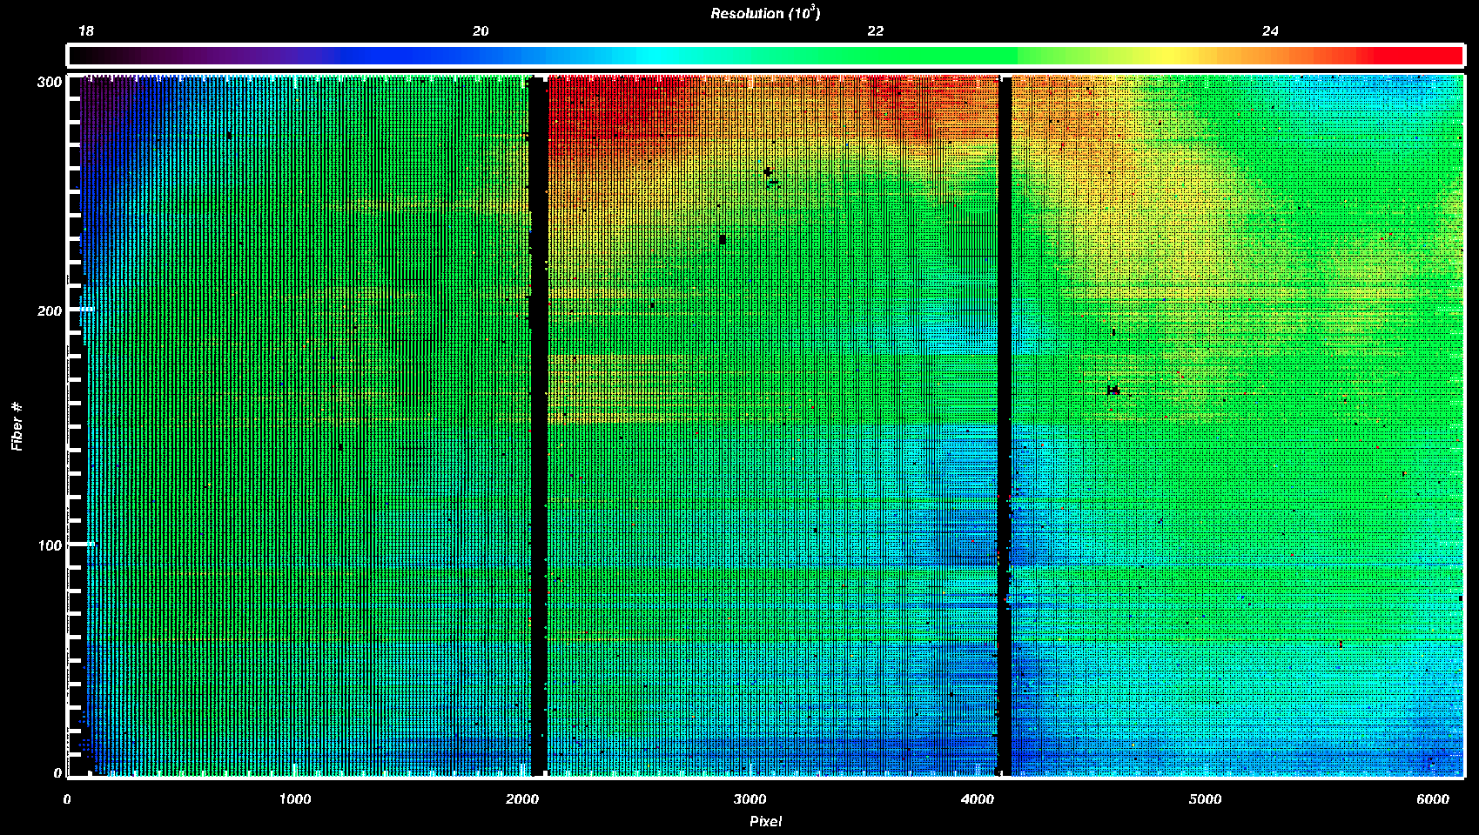
FFP+APOGEE
FFP Provides: Resolution, PSF, Persistence, and Instrumental Drift calibration……

Slide 26
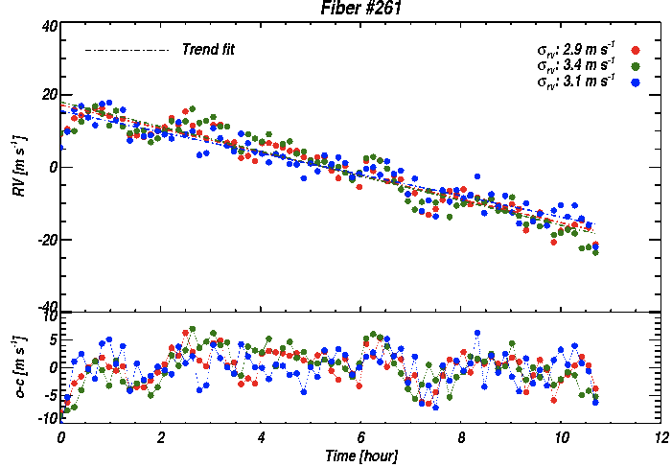
FFP+APOGEE
~3-5m/s structure seen after removing ~50m/s Linear trend. Calibration is KEY!

Slide 27
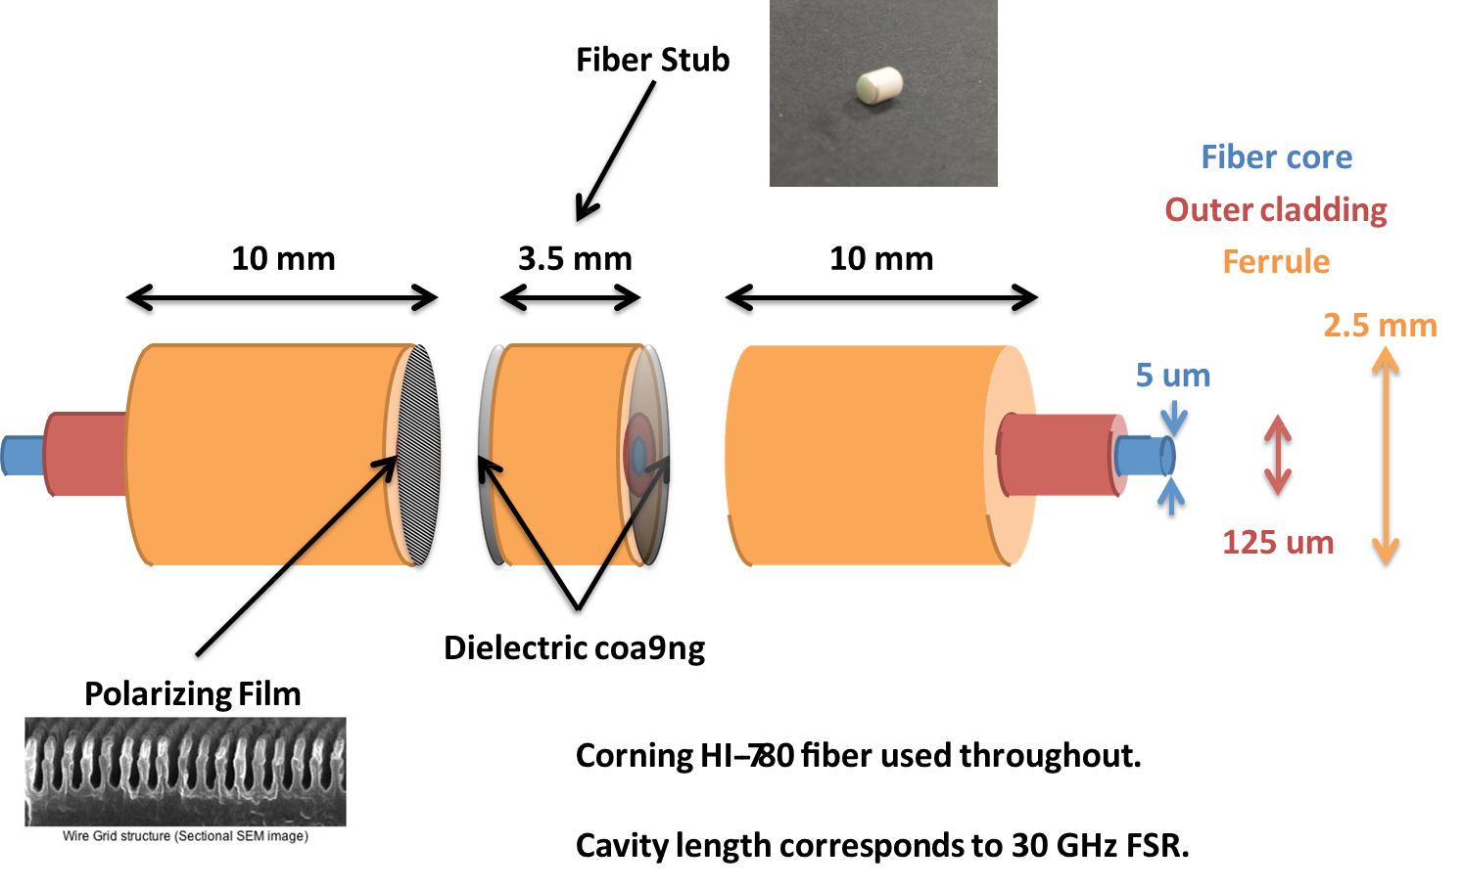
Calibration Is KEY: Z, Y, J FFP for HPF
A temperature stabilized single mode fiber fabry perot (FFP) device is also part of the calibration sequence, providing <1m/s stability over many days and relaxing constraints on the laser frequency comb
Sam Halverson, Phd Thesis

Slide 28

Challenges: Temperature &
Pressure Control
HPF Cryostat is based on the very successful design of the SDSS-APOGEE NIR Spectrograph

Slide 29
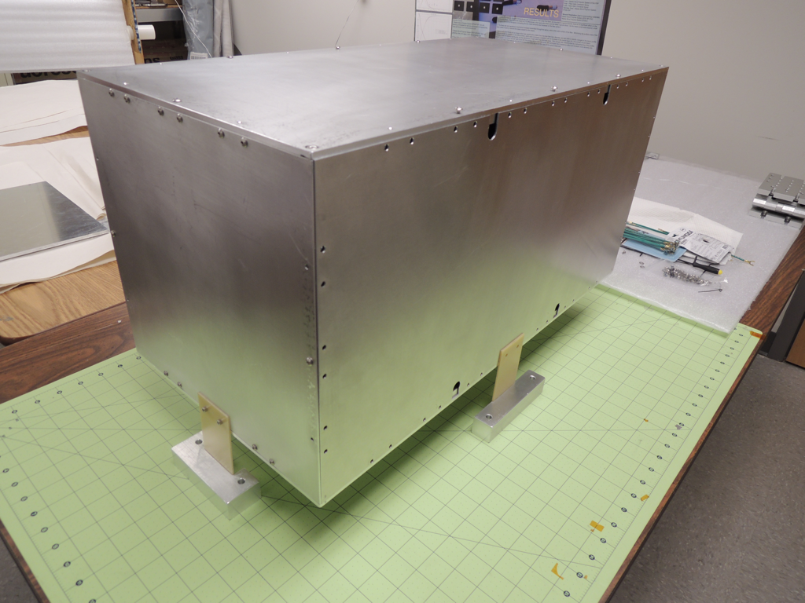
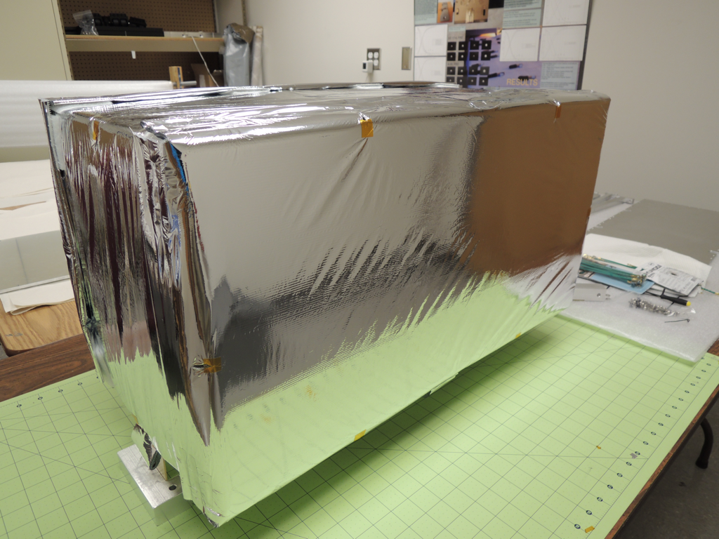
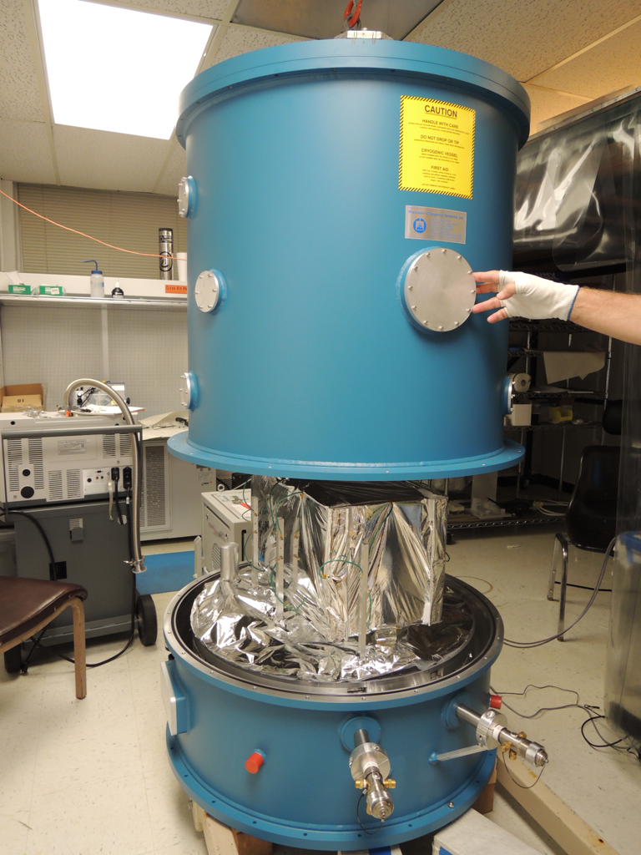
Challenges: Temperature
Control
Concept is to cool with radiative coupling.
Sides of enclosure coupled to LN2 with straps
Control sides of enclosure with heaters to ~1mK, let the radiative coupling cool the bench with the optics. ACTIVE CONTROL
1:4 Scale model of HPF Thermal shield, MLI blanket, bench, and prototype control system

Slide 30
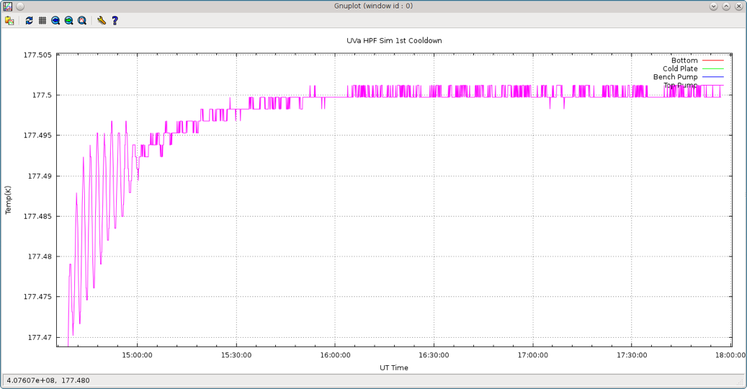
Challenges: Temperature
Control
Retune PID
~1.5mK stability
First Tests results from Dec 2012

Slide 31
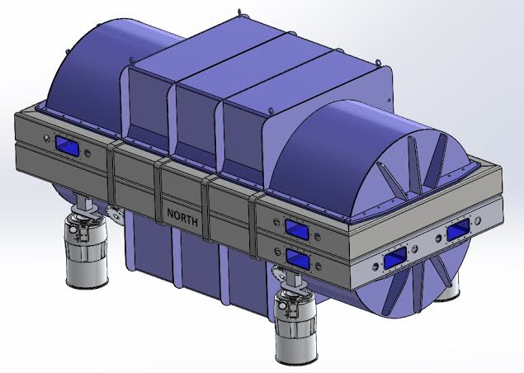
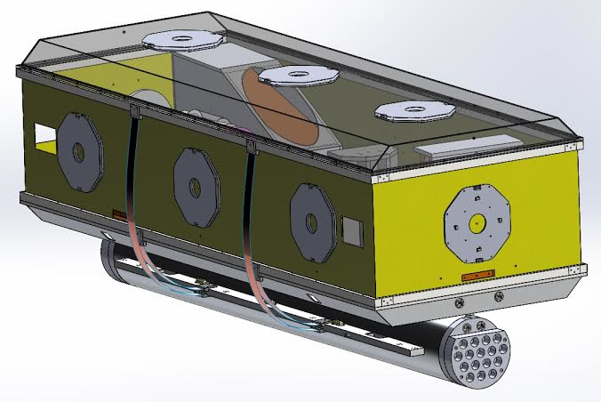
Thermal Control & Cryostat
Inner Radiation Shield
HPF Cryostat
HPF Cryostat and Inner Radiation Shield. Thermal control to milli-Kelvin level demonstrated in a test cryostat using passive copper straps attached to LN2 tank in combination with active control of heater panels

Slide 32
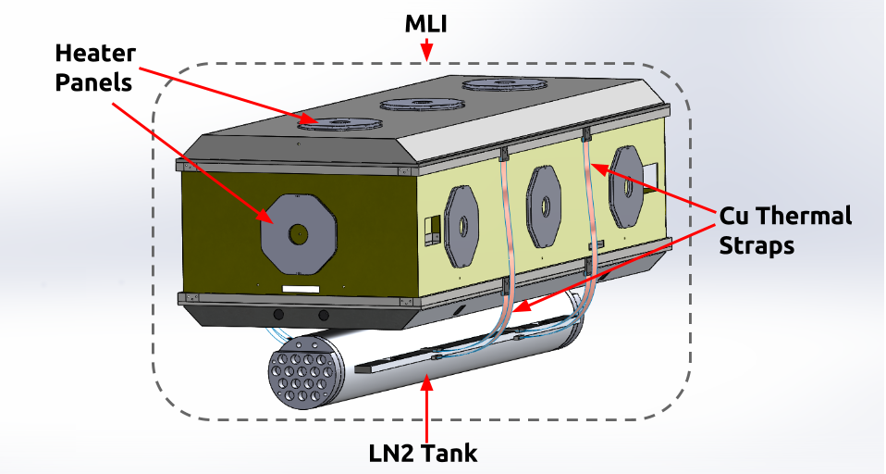
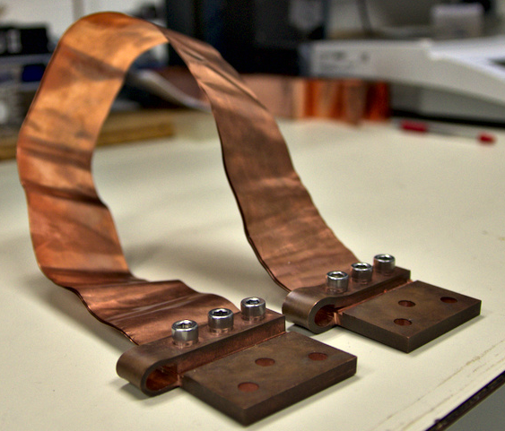
Thermal Control & Cryostat
Active control of Radiation shields using heater panels. Instrument radiatively coupled to the shield. LN2 tank decoupled from AL6061-T6 instrument bench.

Slide 33
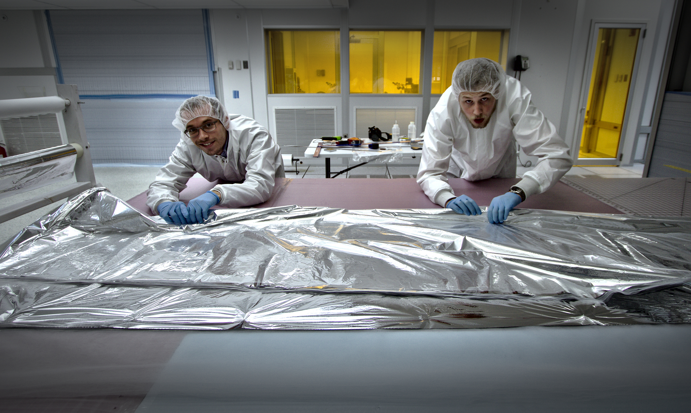
Thermal Control & Cryostat
12 and 24 layer MLI Blankets being made in-house clean room where HPF will be integrated at PSU with Mylar and Bridal Veil (nylon). Blankets assembled using Nylon tag pins and some stitching.

Slide 34
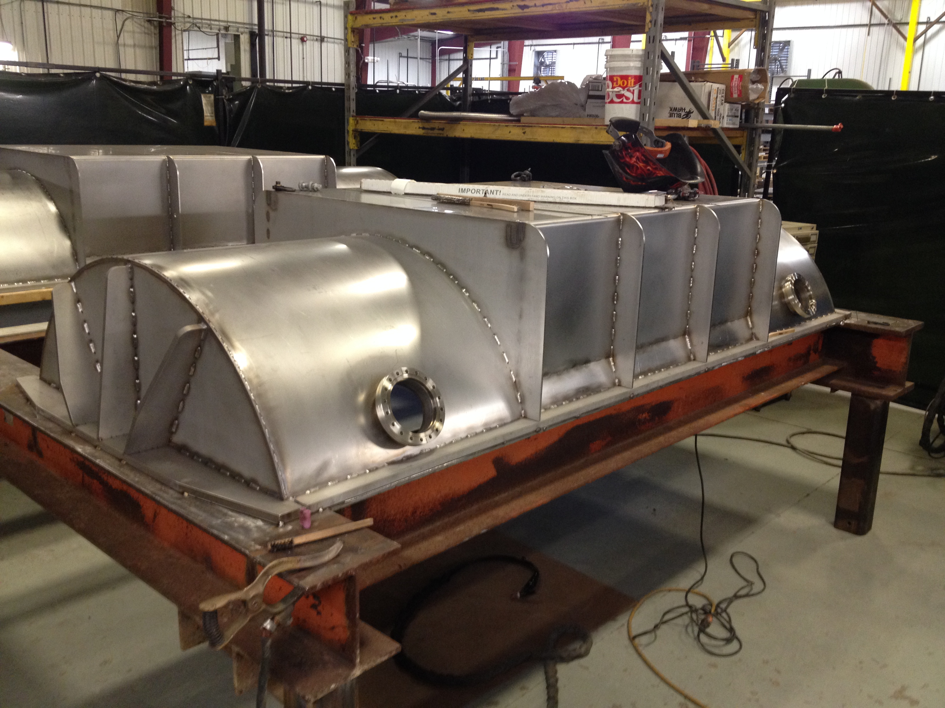
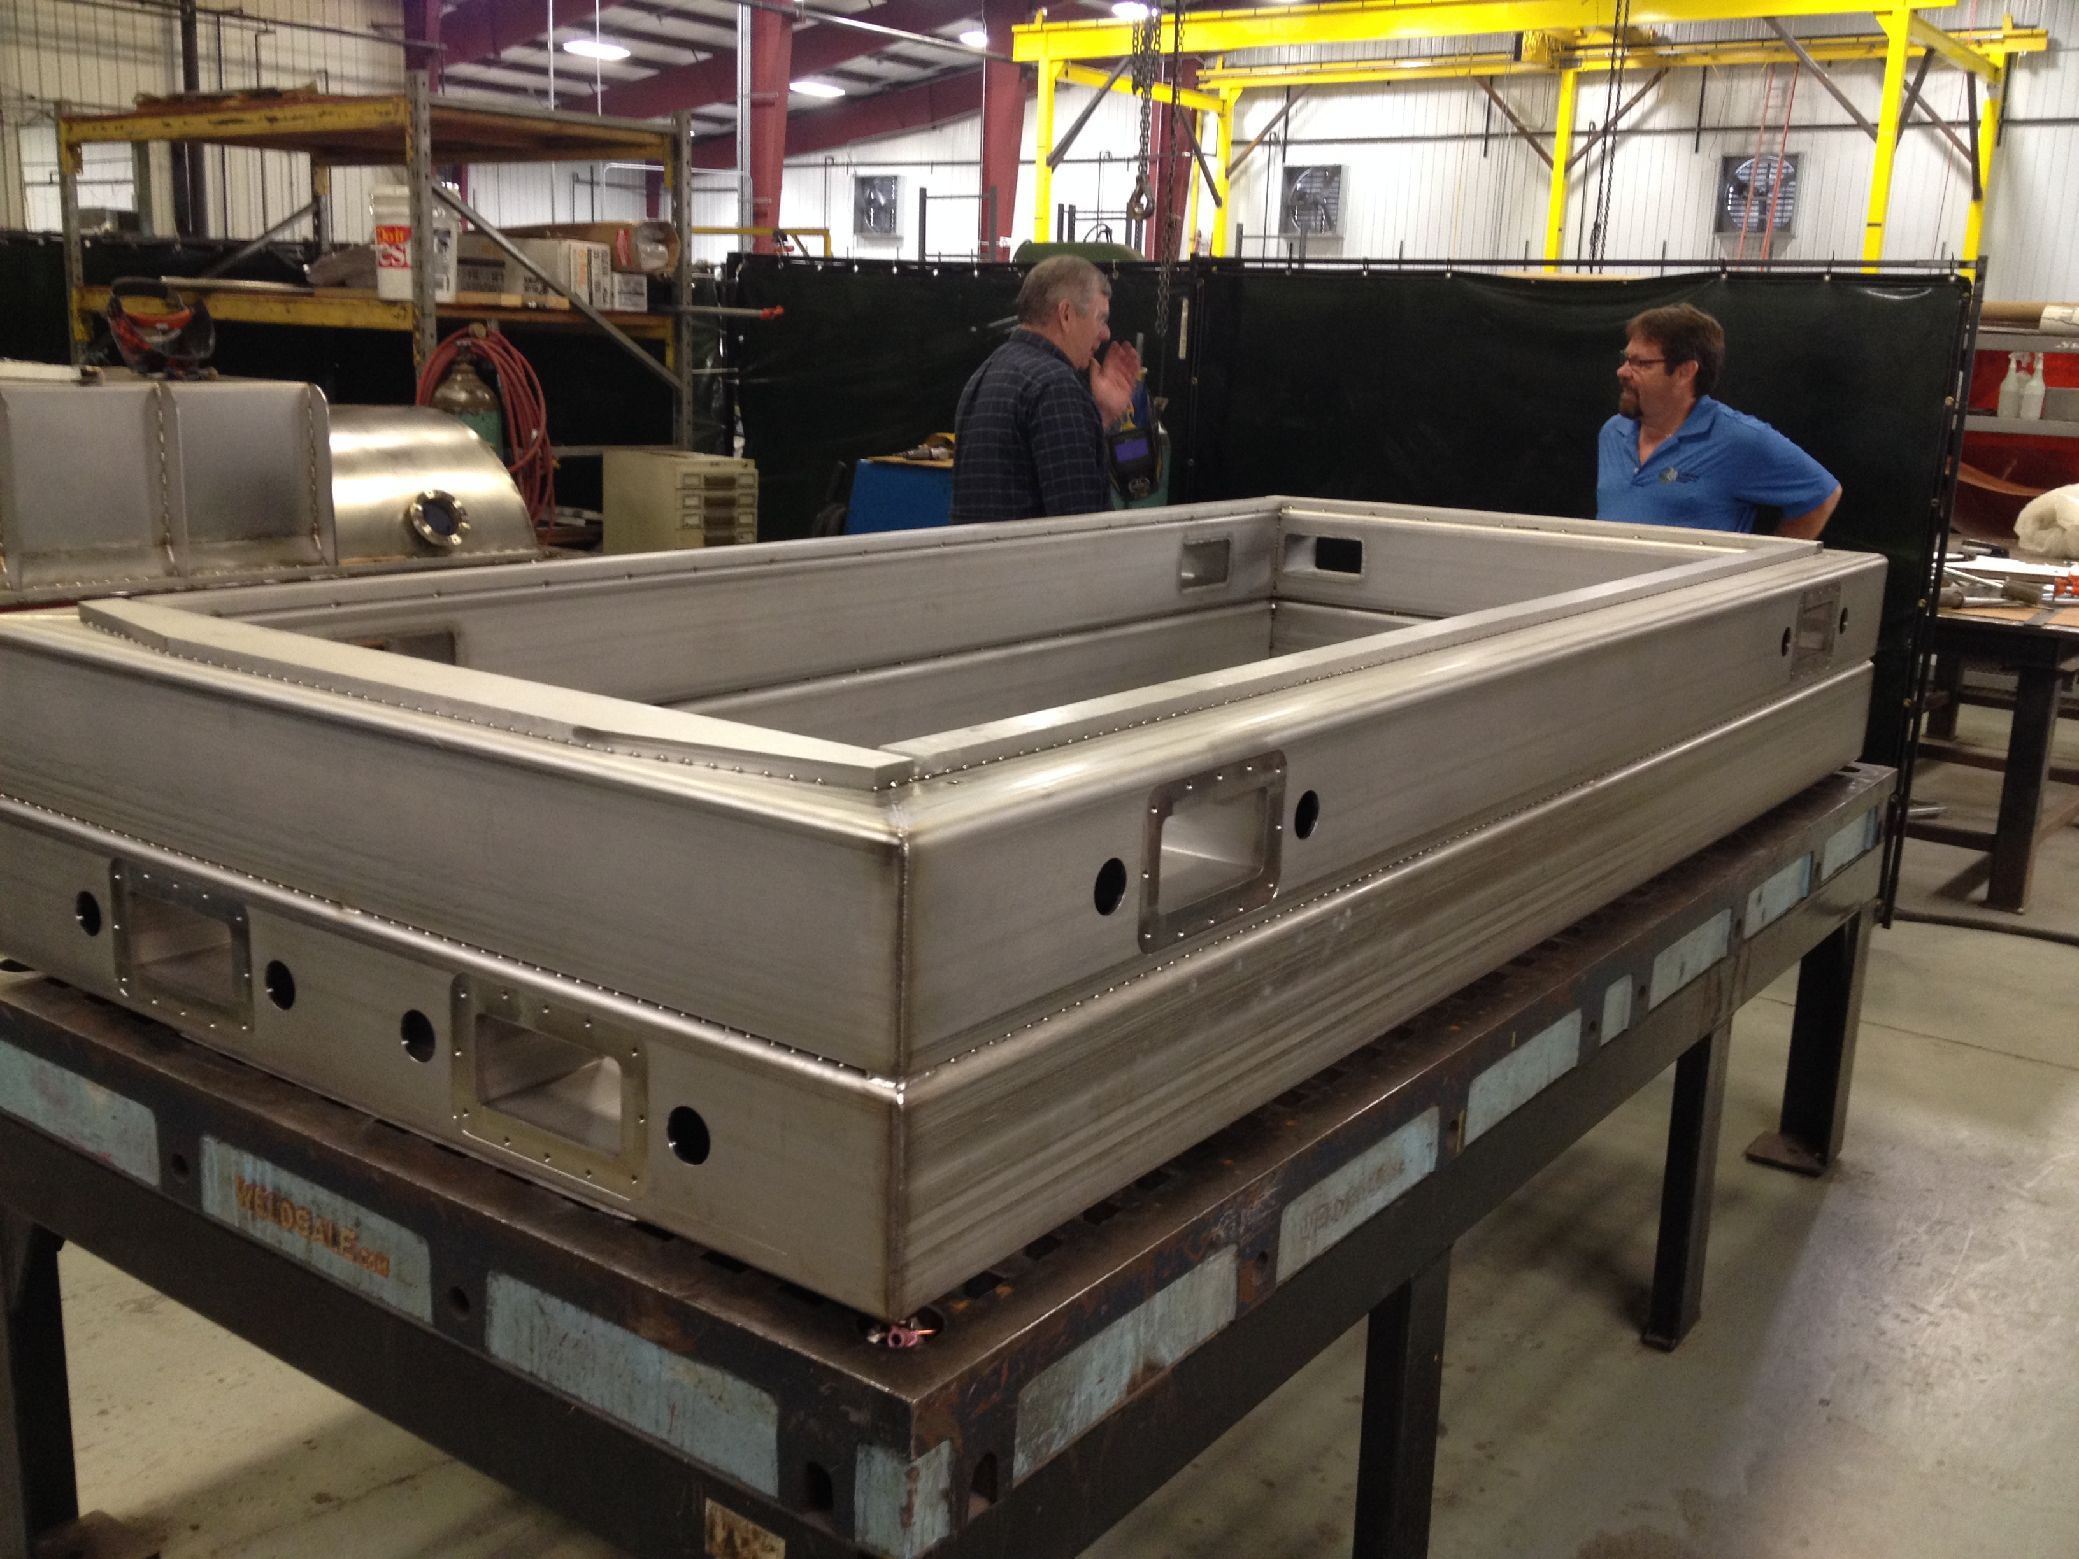
Thermal Control & Cryostat

Slide 35
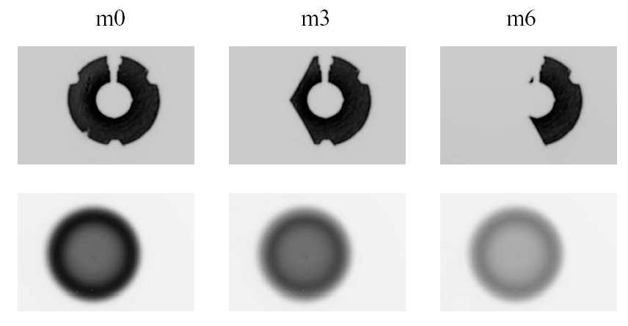
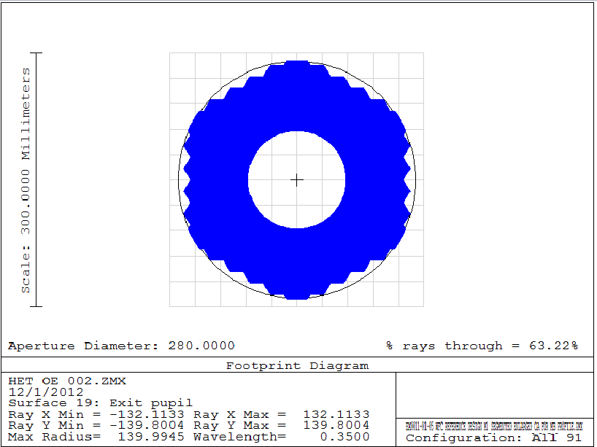
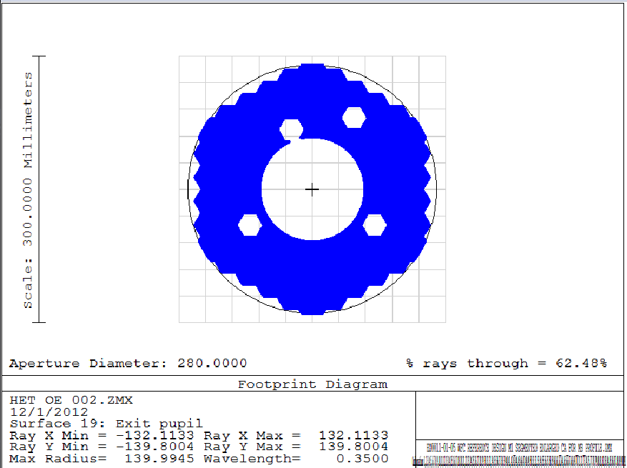
Challenges: Scrambling
HET pupil shape varies significantly with tracker position (HET far-field measurement simulator). Can cause changes in the PSF and spurious RV shifts.
Far field image can vary even at track center.

Slide 36
Scrambling Gain
Challenges: Scrambling
Obviously want as high a scrambling gain as possible in near and far field without losing too much light.
The ideal scrambler for fiber fed instruments is effective in both near and far field, is compact and easy to align, and has high throughput.

Slide 37
Scrambling Measurements

Slide 38

A ball lens as efficient double-scrambler
With appropriate glass, diameter, and coating, high throughput (~80%) is achievable with simple mating sleeve, off-the-shelf connectors for quick prototype tests.
2.0 mm ball lens
FC mating sleeve
FC-connector
FC-connector
Rubber O-rings
Roy and Halverson et al. in prep

Slide 39
Scrambling Gain Results
Octagonal Fiber
Octagonal + Circular Fiber
Octagonal + DS + Octagonal
Input
Input
Input
Near-field
Near-field
Near-field
Far-field
Far-field
Far-field
SG_{NF} = 200
SG_{FF} = 300
SG_{NF} = 3000
SG_{FF} = 1000
SG_{NF} = 12,000
SG_{FF} = 10,000
Roy and Halverson et al. in prep

Slide 40
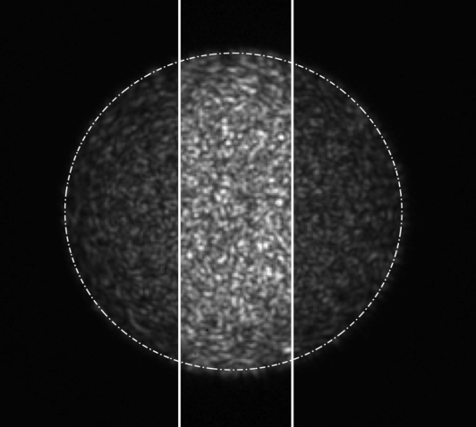
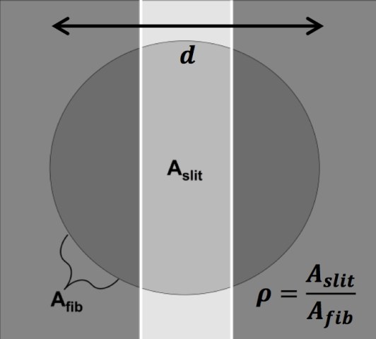
Modal Noise In Optical Fibers
Imperfections, stresses in fiber core, changes in input will change mode distribution, limiting achievable SNR
Modal Noise is worse in the IR
Worse for narrowband spectra (e.g. calibration sources such as frequency combs, high-finesse etalons).
Goodman & Rawson 1981
Lemke et al. 2011
Modal noise mitigation
Notes:
Truncation of fiber output (e.g. by an entrance slit) leads to intensity decorrelation, centroid drifts.
Mode illumination variations manifest as PSF variations at detector.
Coherence, v, typical values of 1 for coherent sources, 0.01 – 0.05 for continuum sources.
Particularly a problem for high resolution spectrographs, narrow slits/wide fibers. Solving modal noise with coherent sources automatically solves for continuum sources.

Slide 41
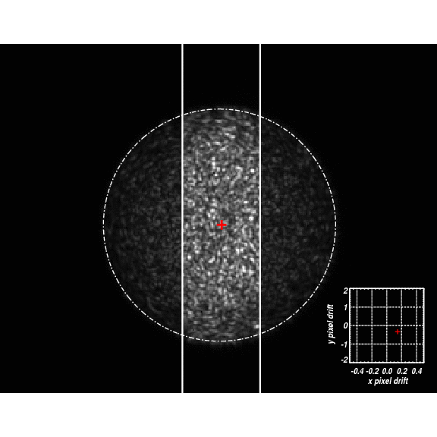
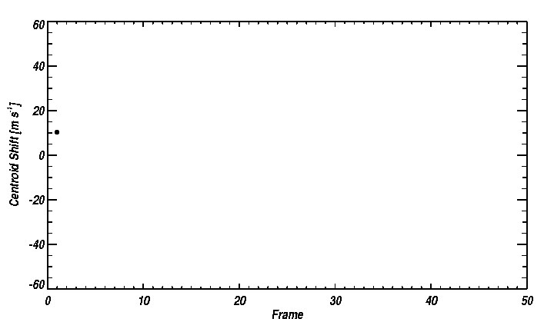
Modal Noise major limitation
in NIR PRV Work
With many instruments turning to coherent laser sources for calibration, modal noise is a significant addition to the error budget.
  PSU Pathfinder LFC limited to 10-20 m/s precision with LFC
σ_{v}= 20 m s⁻¹
200 micron circular fiber illuminated with 1 MHz 1550 nm laser source
Mahadevan & Halverson+ 2014

Slide 42
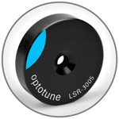
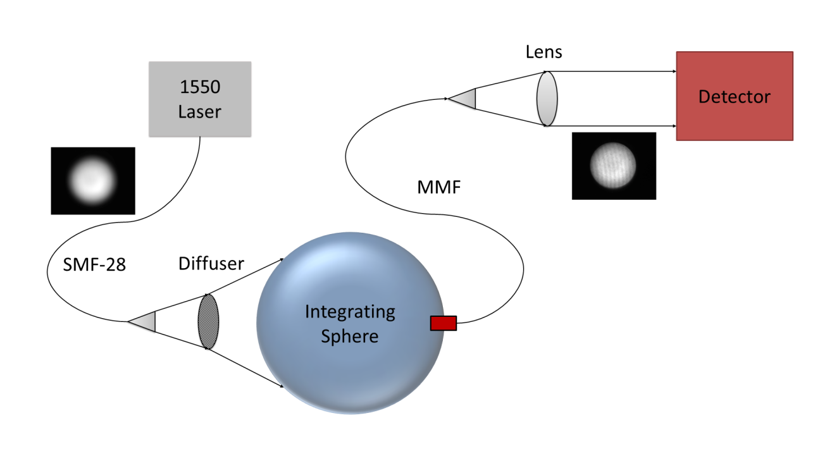
New solution: Dynamic Diffuser
OptoTune laser speckle remover
Oscillates laterally in x & y
Diffuser
Beam
Modal noise mitigation
Mahadevan ,Halverson, Ramsey et al. 2014

Slide 43
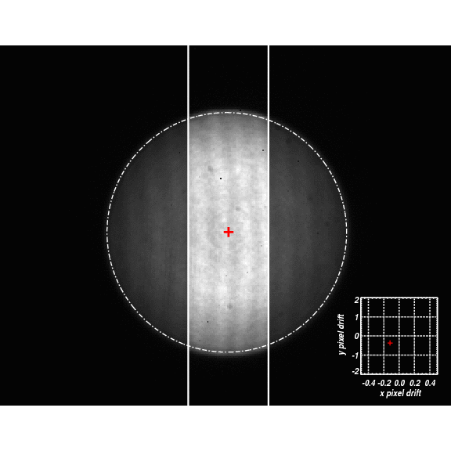
Centroid drift comparison
Integrating sphere
Integrating Sphere +Dynamic Diffuser
Modal noise mitigation
Notes:
Mode distribution was changed between each frame, allowed to settle.
----- Meeting Notes (3/27/13 15:14) -----
the plot on the lower right shows the x and y pixel drift.

Slide 44
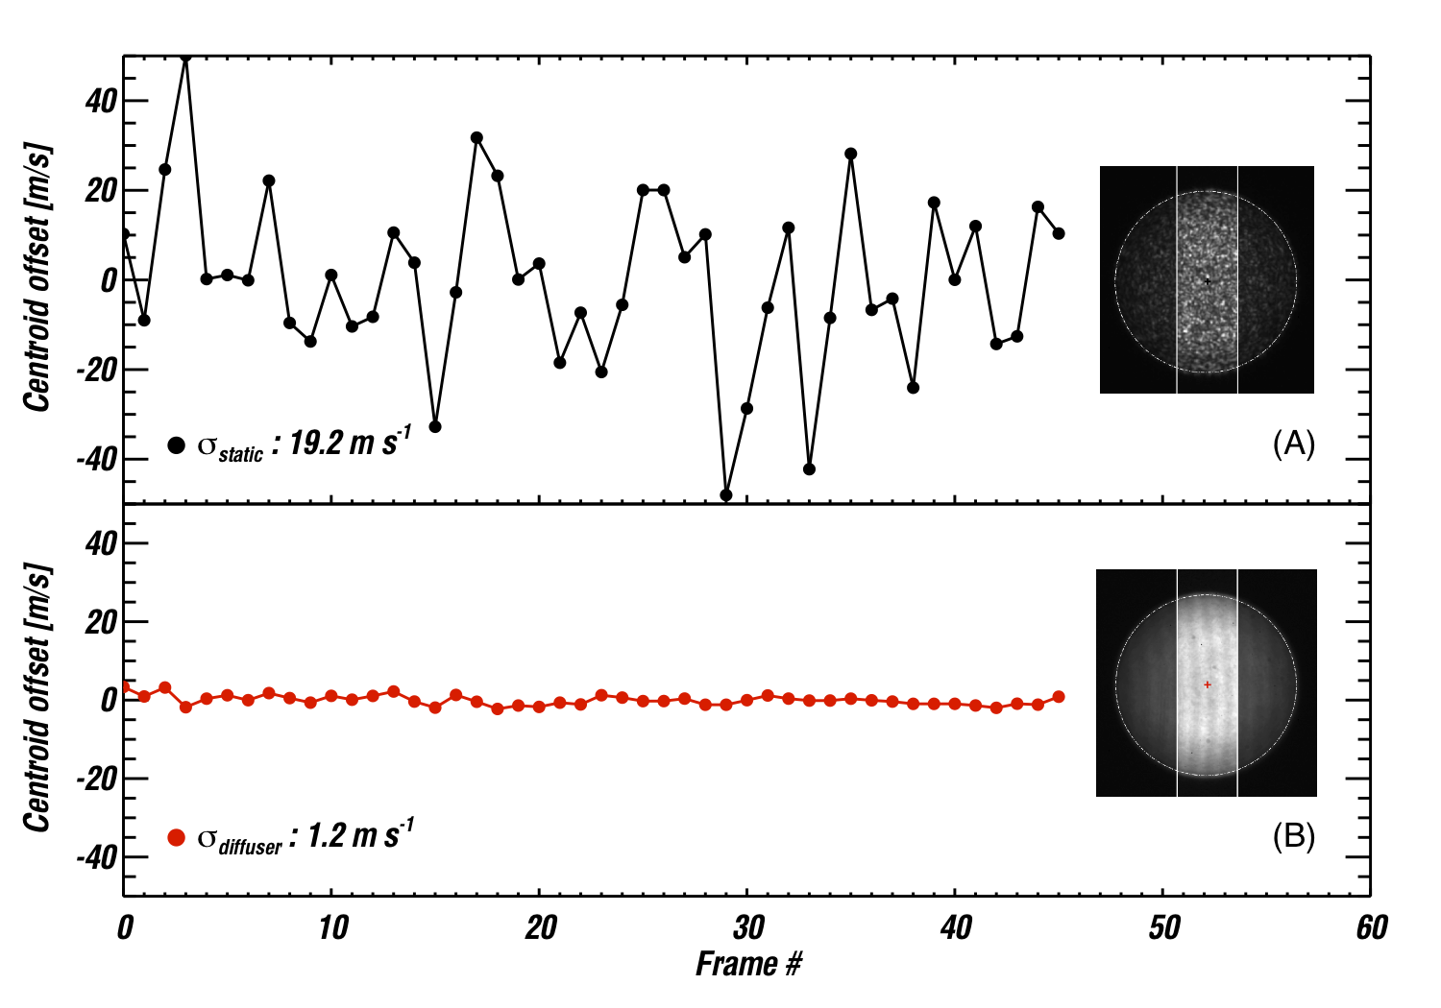
Modal Noise: Solutions For
Highly Coherent Sources
No diffuser
Diffuser on,
Coupled through integrating sphere
Assumes R=50k, 300 micron fiber with 100 micron slit at 1550 nm.
Notes:
Photon limited drift error is 30 cm/s. Note this is ONLY ONE LINE, 10MHz laser line. (R 50,000 is 4 GHz at 1550)
----- Meeting Notes (5/24/13 10:08) -----
Worst case scenario for one line, noise is random

Slide 45

Modal Noise: Solutions For
Highly Coherent Sources
In single emission line
σ = 0.3 m/s
σ = 1.3 m/s
σ = 19 m/s
Rot. Mirror + Int. Sphere
Diffuser + Int. Sphere
Int. Sphere
All tests use integrating sphere with 200 micron circular fiber.
In-between frames, the test fiber was perturbed and allowed to settle.
Halverson+ 2014

Slide 46

Baseline Fiber Feed

Slide 47


Earths Stellar Activity: Lower in the NIR
Stellar activity induced noise is lower in the NIR than the optical. RV variability for Sun estimated using SOURCE SIM solar spectral irradiance data and the FF’ technique (Marchwinski et al. 2014 in press)

Slide 48
In Summary
HPF is a large facility class cryogenically cooled fiber fed spectrograph on a 10m telescope being optimized for ultra-precise RV measurements of M dwarfs
Cryostat and temperature control being built.
Challenges in calibration and modal noise overcome by ongoing R&D
Stellar activity in systems is critically important in understanding RV signal using NIR observations.

